Slide 1



Wintersession 2024
Investing 101

Slide 2

Today’s Webinar
Format
We will ask our presenter to answer the questions submitted before the webinar first, then turn to new questions.
Reducing Background Noise
Make sure you are in a quiet place without distractions.
Using the “Questions” Feature
If you have a question, use the Q&A feature to let us know.
Presentation & Recording
This presentation is being recording and will be posted on our YouTube channel to re-watch.

Slide 3

Who is HUECU?
Better Value
As a not-for-profit, HUECU puts members first in the form of better rates on savings and loans, lower & fewer fees, and more free services and perks.
Since 1939, HUECU offers a variety of quality financial services to the Harvard community.
Better Service
Credit unions consistently outperform banks in metrics of customer service and satisfaction. You have a name not just an account number here.
Better Business Model
The member controlled co-op model is always focused on operating in the best interests of our members.
Better For the Community
Your money stays local when you bank with HUECU. We give back to our community by offering financial education programs and support for local charitable organizations.

Slide 4

College Life Accounts Support
Students Financial Independence
Student Focused
Fee-Free
Access For All
HUECU offers personal finance sessions and access to GreenPath Financial Wellness. College life is student friendly designed with the Harvard Undergraduate in mind.
Fee-free account with FREE incoming wires and FREE incoming bank transfers.
Membership extends to all family members, and you can link external accounts and customize shared access to Online Banking, Mobile banking, and Apple Pay ready.

Slide 5
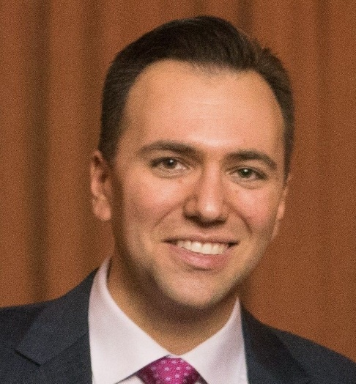
Today’s
Presenter
Shahar Ziv is the co-founder of the Harvard Personal Financial Management Wintersession course and is thrilled to be back to teach the program for the 13th year. He is a graduate of Cornell and Harvard Business School and currently works at PayPal as the Vice President of Enterprise Services Product and Strategy. He is a contributing writer for Forbes and serves on the Board of Directors of the Harvard University Employees Credit Union (HUECU).
LinkedIn: https://www.linkedin.com/in/shaharziv/
X: @ziv_shahar
Instagram: ziv_shahar
Shahar Ziv
Vice President of Enterprise Services Product at Paypal

Slide 6


BUILDING WEALTH:
AN INTRO TO investing
Shahar Ziv
shahar@acingyourfinances.com
@ziv_shahar

Slide 7










Why should you listen to me?
I’ve Worked With. . .
I’VE WORKED WITH
Experience
Harvard: Co-founder and 13-Year Instructor of Personal Financial Management Program
Columbia: Lead workshops for Master’s and PhD students at Graduate School of Arts & Sciences + Journalism School
Wharton: Teach programs for rising freshmen and sophomores from underrepresented groups
NYU: Offer tax workshop for graduate students
Johns Hopkins and UChicago: Workshops for all years
Employers: Skadden, Mt. Sinai Hospital; DoorDash
Expertise
Forbes: Personal Finance Contributing Writer
Consortium on Financing Higher Ed – Keynote Presenter
U.S. Conference of Mayors: Guest speaker
MY BACKGROUND
Objectivity
Unaffiliated and unbiased
No conflicts of interest
Do not market, sell, or receive compensation from other products or services
MBA
BA – Economics
(Distinction in all subjects;
Phi Beta Kappa)
Notes:
Who am I or. . . . Why should you listen to me
PASSIONATE
Backstory – moved to US when I was 3, my dad was a grad student, didn’t grow up with a ton of money
Undergrad at Cornell → took a class
Noticed that my friends came to me with questions
And that I had an understanding of what I should be doing with my mone
HBS
Research→ HLS → Howell Jackson (Consumer Finance)
Helped found a program at Harvard College to teach students fundamentals (this was in 2012 and I have been going back ever since)
Have done a lot more work with universities (both undergrad and grad) as well as new employees at places like DoorDash and Mt Sinai
Know a lot
MOST IMPORTANTLY – I am unaffiliated –pays me to come her, but I don’t get any other money from products or services that I recommend to you. I don’t want to do your taxes, refinance your student loan or oversee your investments. I’m not here to sell you anything. That’s really important, because when it comes to money, there are many people out there who may not have your best interest at heart and may give you conflicted advice. This is especially true for soon to be high powered lawyers like yourselves, because you’ve worked really hard and your earning power and potential is impressive.
It is really important to undertand the people giving you advice, what are their interests, do they have any conflicts. At HBS, I learned how to evaluate start-ups and new companies. And the first question is always “how do they make money”? It’s a question youshould ask about anyone you are hiring or anyone giving you advice

Slide 8

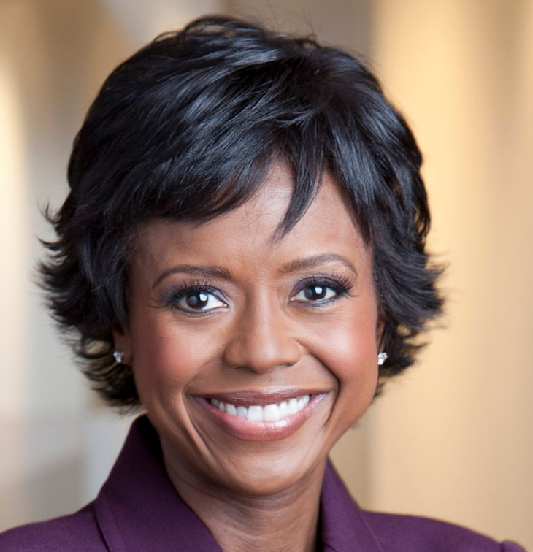
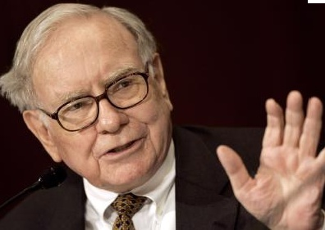
Setting Expectations
X
X
facts
insights
Strategies

Slide 9

The secret to investing…
X
Invest everything in

Slide 10

The secret to investing…
X
Invest everything in

Slide 11
The secret to investing…
Be average

Slide 12



The Bet
$1,000,000
Notes:
75 minutes is not enough time to turn you into Warren.
Also, many of you have significantly more institution investing experience than me working at banks, hedge funds, etc. You won’t here me talking about Sharpe ratios or derivatives.
This is more about giving you a framework and tools for how to think about personal investing.

Slide 13
The results
Notes:
75 minutes is not enough time to turn you into Warren.
Also, many of you have significantly more institution investing experience than me working at banks, hedge funds, etc. You won’t here me talking about Sharpe ratios or derivatives.
This is more about giving you a framework and tools for how to think about personal investing.

Slide 14
Why Investing Is critical
0.09%
1.81%
Average Savings Interest Rate
(0.01% - 2.0%)
2019 Inflation Rate
1.1%
8.3%
Bonds
(1914 -2014)
(adjusted for inflation)
S&P 500
(1914 -2014)
(adjusted for inflation)
Notes:
75 minutes is not enough time to turn you into Warren.
Also, many of you have significantly more institution investing experience than me working at banks, hedge funds, etc. You won’t here me talking about Sharpe ratios or derivatives.
This is more about giving you a framework and tools for how to think about personal investing.

Slide 15
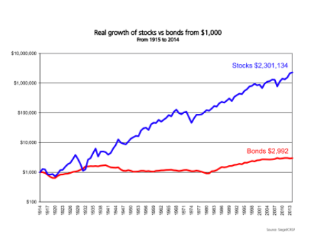
Real growth of Stocks Vs Bonds
Notes:
75 minutes is not enough time to turn you into Warren.
Also, many of you have significantly more institution investing experience than me working at banks, hedge funds, etc. You won’t here me talking about Sharpe ratios or derivatives.
This is more about giving you a framework and tools for how to think about personal investing.

Slide 16
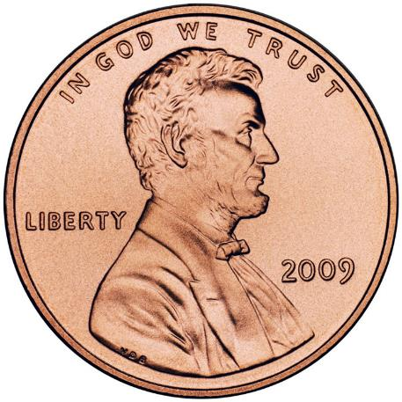


A Penny for your thoughts
Day 1
Day 31

Slide 17
Time value of money
Day | Start – Day 1
1 | $0.01
2 | $0.02
3 | $0.04
4 | $0.08
5 | $0.16
6 | $0.32
7 | $0.64
8 | $1.28
9 | $2.56
10 | $5.12
15 | 163.84
20 | $5,242
25 | $167,772
29 | $2,684,354
30 | $5,368,709
31 | $10,737,418
Start – Day 2
-
$0.01
$0.02
$0.04
$0.08
$0.16
$0.32
$0.64
$1.28
$2.56
$81.92
$2,621
$83,886
$1,342,177
$2,684,354
$5,368,709
Start – Day 10
$0.01
$0.32
$10.24
$327
$5,242
$10,485
$20,971
Key Observations
Exponential growth because of compounding (“power of compound interest”)
If you start on Day 1, you end up with 2x more than if you start on Day 2
The last double matters most, but to get to it, you have to start early
Delay of 10 years has drastic consequences (need to invest more to “catch-up”)
=
=
=
=
Notes:
Factor of

Slide 18
Key Takeaway #1
START SAVING EARLY & SAVE CONSISTENTLY

Slide 19

Introduction
to Investing

Slide 20

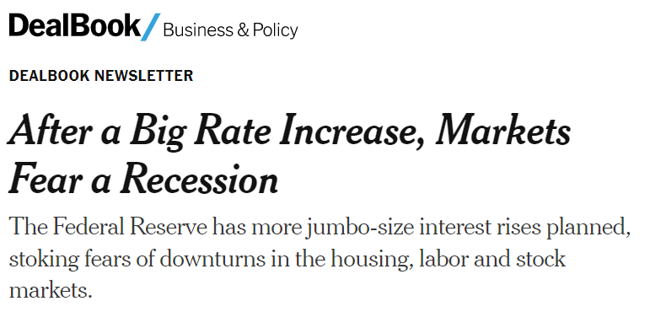
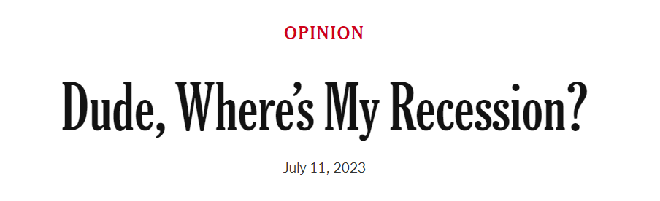

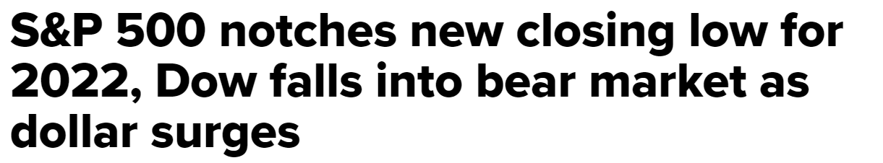
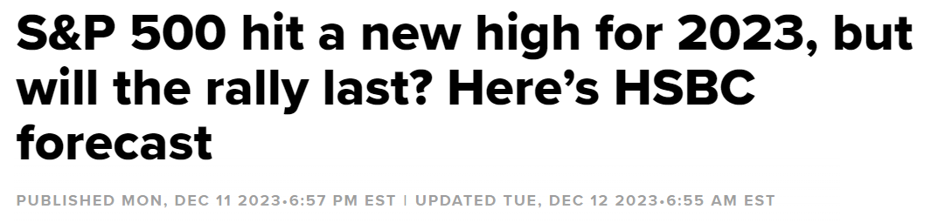
headlines

Slide 21
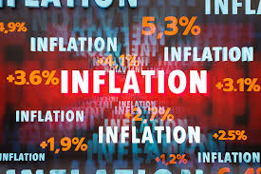

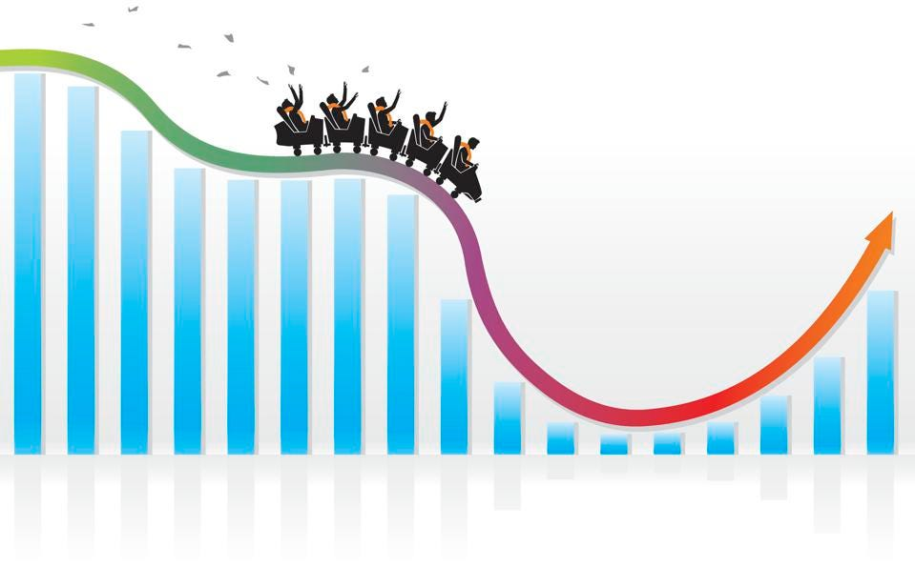
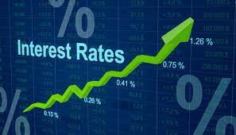
Inflation
Market Volatility
War
ChangingInterest Rates

Slide 22

themes
  Saving vs. Investing
  Key Terms
  Time Horizon
  Risk Level
  Alignment with Goals
  Alone or Getting Help?

Slide 23




Before You Start to Invest
  Build up a 3-6 month emergency fund
  Pay off all your high-interest debt (e.g., credit cards)
  Maximize contribution to your retirement plan (especially if your employer matches)
  Save for other important [short-term] needs (e.g., down payment)
Paid In Full
Short-Term Goals
Emergency Fund
Notes:
Savings – focused on short-term goals
Keep in very safe accounts
Bank/Credit Union Savings account
Certificate of Deposit (CD)
Easy access (i.e. “liquid”)
Tradeoff: easy access and negligible risk to lose money vs. low chance of making a lot of money
Investing – focused on longer term goals
No guarantee that you’ll make money (could lose some or all)
But potential for higher earnings

Slide 24
Terminology to know
DEFINITION
EXAMPLES
CHECKINGS/ SAVINGS ACCOUNT
Principal contributions are protected from loss
Guaranteed interest on money you put in
Credit Union checking account
Online bank savings account
MONEY MARKET
Certificates of Deposit
Short-term government loans
12 month CD
BONDS
Loans made to a company or the government. A bond is an IOU from a company/gov’t
Treasury bond (gov’t) or corporate bond
STOCKS (EQUITIES)
Ownership in a company
Price appreciation and dividend payments
Tesla, Apple, Google
MUTUAL FUNDS
Collection of stocks or bonds
Vanguard Total Stock Market Index Fund

Slide 25
Translating Risk into Specific Investment Choices
CHECKINGS/ SAVINGS ACCOUNT
MONEY MARKET
BONDS
MUTUAL FUNDS
STOCKS
CRYPTO
LOWER
RISK
HIGHER

Slide 26

Investment risk: Defining Time Horizon
    Home Purchase
    Future Education
    Vacation and Travel
    Capital Preservation
    Paying Off Credit Card Debt
    Retirement Savings
SHORT TERM
MEDIUM TERM
LONG TERM

Slide 27


Examples
You invest $1000 in stocks….
+53%
-27%
In 1 Year
OR…

Slide 28
Examples
You invest $1000 in stocks….
+11%
+8%
In 25 Years
OR…

Slide 29
Implications
Range of Annual Returns On Common Stocks For Varying Time Periods (‘50-’94)
60%
52.6%
50%
40%
30%
23.9%
20%
17.6%
16.6%
14.6%
11.2%
10%
0%
4.3%
6.5%
7.9%
-2.4%
1.2%
-10%
-20%
-30%
-26.5%
-40%
1-Yr
5-Yr
10-Yr
15-Yr
20-Yr
25-Yr
Source: MyMoneyBlog

Slide 30
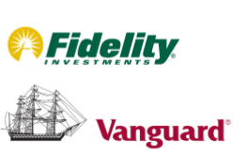
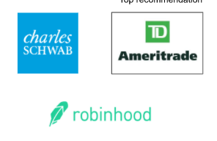
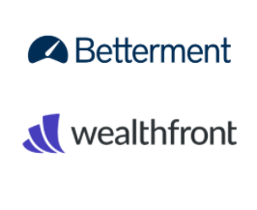
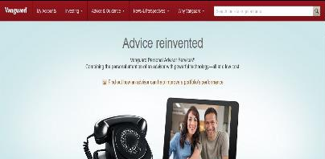
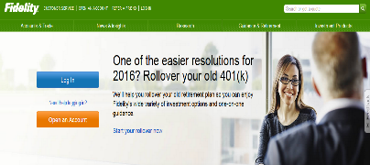
Where to open an account?
BROKERAGE FIRM
ROBO ADVISOR
Notes:
One of the few times being “average” is good

Slide 31
What to invest in for medium and long-term?
Mutual funds/Exchange Traded Funds (ETF) offer:
  Automatic diversification
  Convenience
      No need to research individual companies
      No need to pay for individual trades
  Lower costs
Individual stocks:
  Riskier
  Require more attention
  Tangible (“I own part of Apple”)
My Advice:
Focus on mutual funds
If you are inclined, leave a small portion for individual stocks, but treat it as “play money”
Notes:
One of the few times being “average” is good

Slide 32
What to look for in a mutual fund?
GOOD
NOT SO GOOD
Index funds (i.e., “average funds”) – these are passive and you don’t have individuals picking individual stocks
Low Cost
Direct investment (avoid the “middle-person”)
Actively Managed Funds
High Cost (often referred to as an expense ratio)
Hidden fees
Lots of different funds
In general, annuities
Notes:
One of the few times being “average” is good

Slide 33
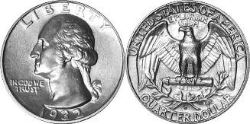
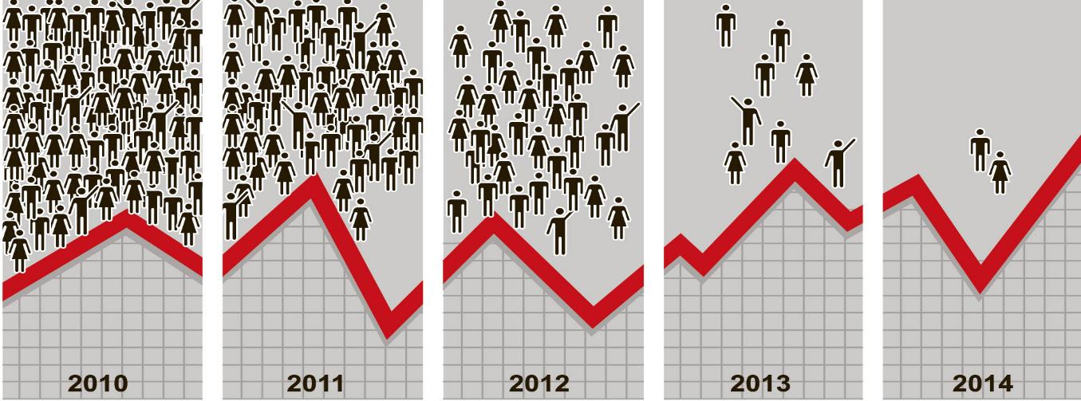
Like Flipping A Coin
2,862
2
Each time finding the same core truth: Very few funds achieved consistent and persistent outperformance. Furthermore, “the data shows a likelihood for the best-performing funds to become the worst-performing funds and vice versa.”
Sources: http://www.nytimes.com/2014/07/20/your-money/who-routinely-trounces-the-stock-market-try-2-out-of-2862-funds.html
Notes:
The S.&P. Dow Jones team looked at 2,862 mutual funds that had been operating for at least 12 months as of March 2010. The team selected the 25 percent of funds with the best performance over the 12 months through March 2010. Then the analysts asked how many of those funds — those in the top quarter for the original 12-month period — actually remained in the top quarter for the four succeeding 12-month periods through March 2014.
The answer was a vanishingly small number: Just 0.07 percent of the initial 2,862 funds managed to achieve top-quartile performance for those five successive years. If you do the math, that works out to just two funds. Put another way, 99.93 percent, or 2,860 of the 2,862 funds, failed the test.
Each time finding the same core truth: Very few funds achieved consistent and persistent outperformance. Furthermore, sustained outperformance declined rapidly over time. And the report said, “The data shows a likelihood for the best-performing funds to become the worst-performing funds and vice versa.”

Slide 34

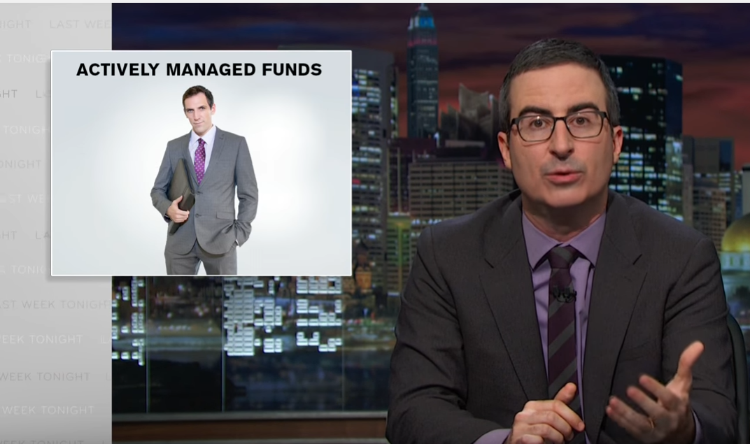
John oliver on fees and active funds
Source: https://www.youtube.com/watch?v=gvZSpET11ZY
Start: 7:55 – 10:06

Slide 35
Remember this one word. . .
fiduciary

Slide 36
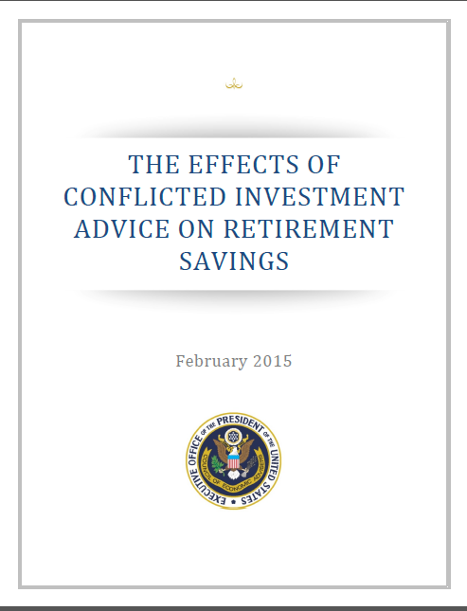

The Market for Financial Advice
Notes:
According to a recent report by the White House Council of Economic Advisers, these salespeople are fleecing hard-working Americans out of $17 billion in retirement funds each year.
Two key dimensions:
Legal standard advice must meet
How they are compensated

Slide 37
Sample Portfolio
Int’l - Developed
US Small
15%
20%
10%
Emerging Mkts
Other
40%
US Large

Slide 38
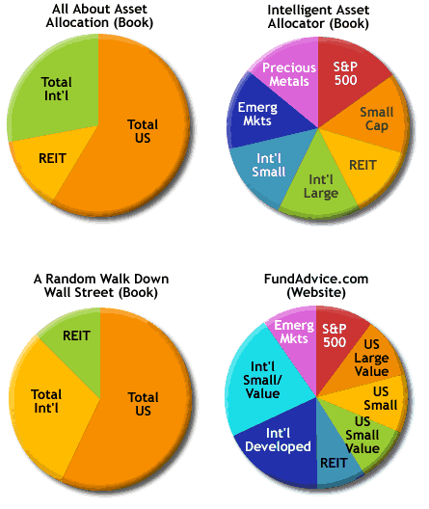
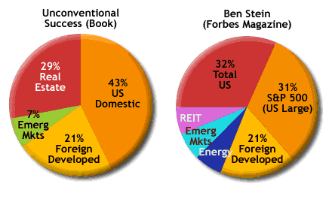
There is no one right answer

Slide 39
A 3 fund portfolio
Bonds
International Stocks
Vanguard:
Vanguard Total Stock Market Index Fund (VTSAX)
Vanguard Total International Stock Index Fund (VTIAX)
Vanguard Total Bond Market Fund (VBTLX)
Fidelity:
Fidelity Total Market Index Fund (FSKAX)
Fidelity Total International Index Fund (FTIHX)
Fidelity U. S. Bond Index Fund (FXNAX)
US Stocks

Slide 40
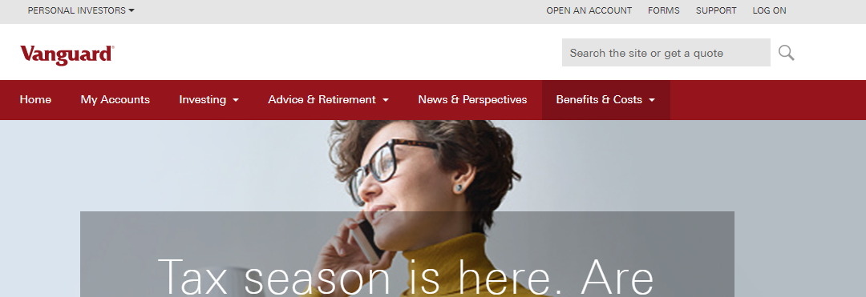
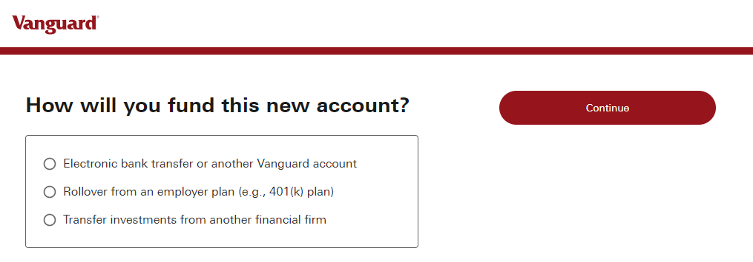
How to open an account

Slide 41
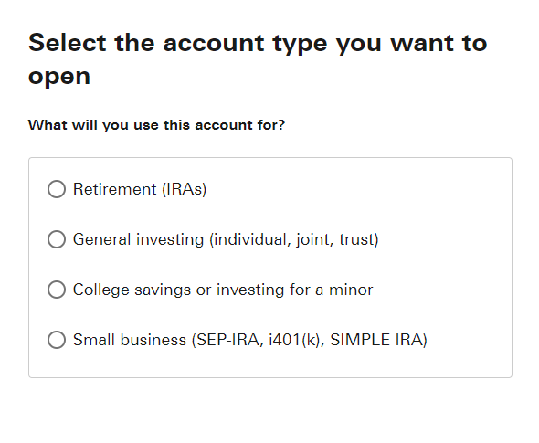
How to open an account

Slide 42
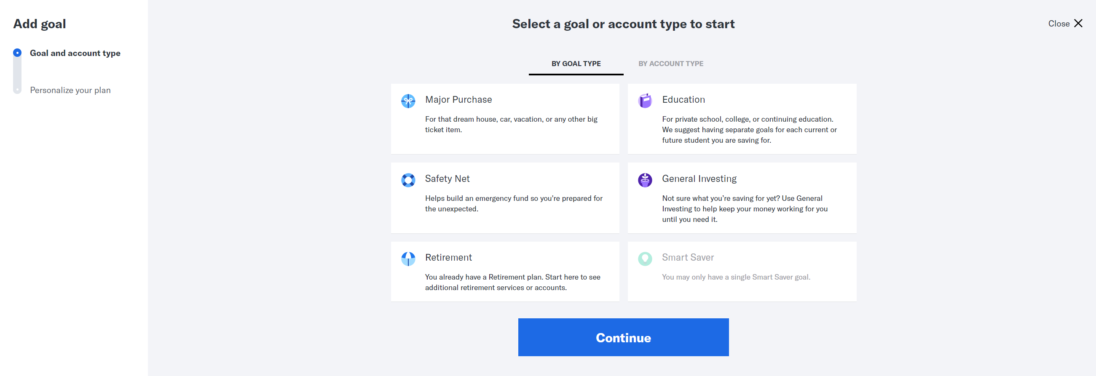
Robo-advisors example

Slide 43
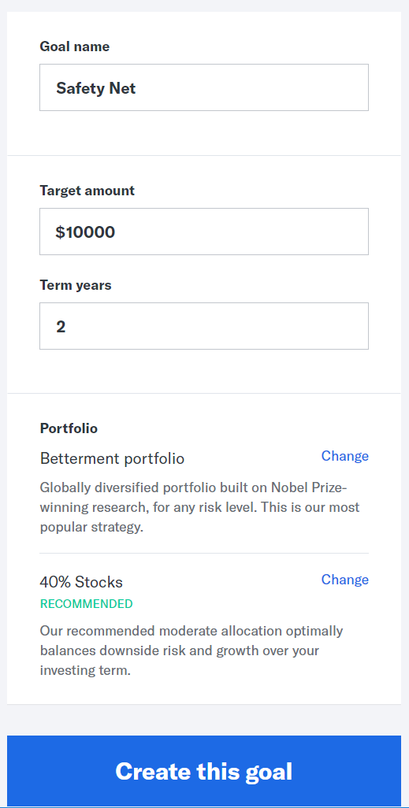
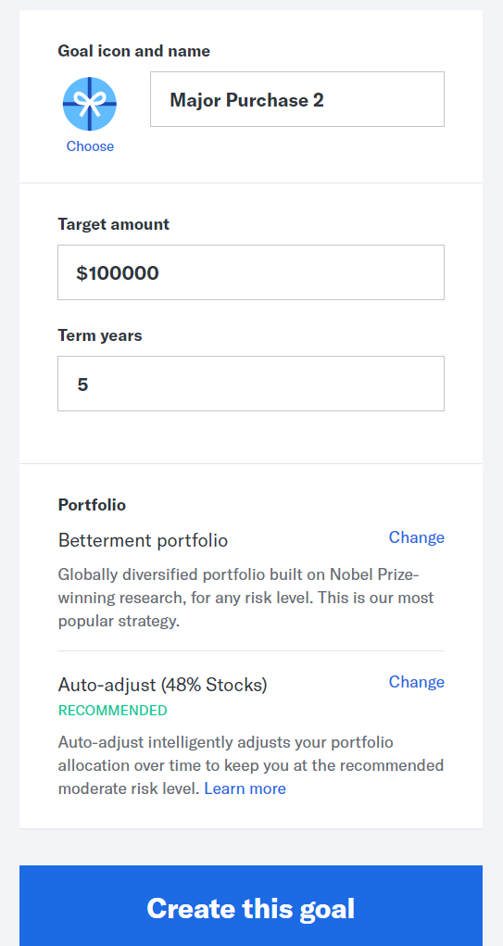
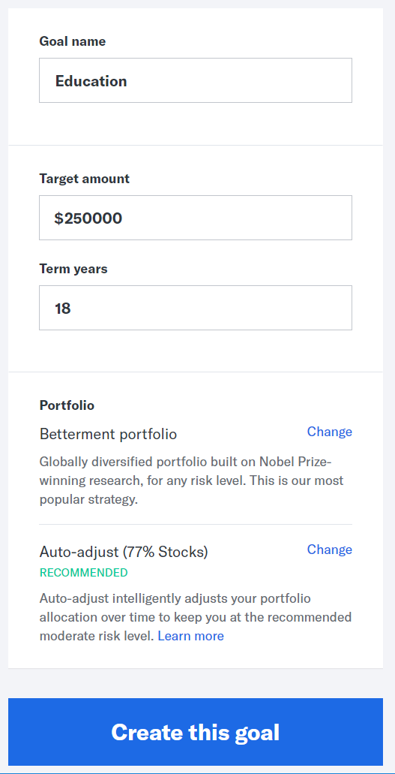
Example cont.

Slide 44

Take the longer-term approach
  Set up a solid investing plan:
    Low-cost index funds
    Steady purchase of stock- and bond-based mutual funds
    A risk-based allocation based on your time horizon
  Rebalance portfolio as time horizon gets closer
  Set it and forget it (i.e., do nothing)
Buying and selling at the right moment isn’t going to happen regularly
Notes:
75 minutes is not enough time to turn you into Warren.
Also, many of you have significantly more institution investing experience than me working at banks, hedge funds, etc. You won’t here me talking about Sharpe ratios or derivatives.
This is more about giving you a framework and tools for how to think about personal investing.

Slide 45

What to do. . . Early in your career
  If you have a longer-time horizon → great time to double-down on putting money into 401(k)/IRA
  Save in emergency fund
  Pay off high-interest debt
  Consider opportunistic investment/savings options (e.g., i-bonds)

Slide 46
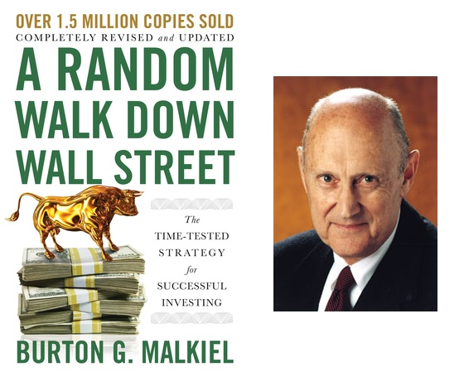

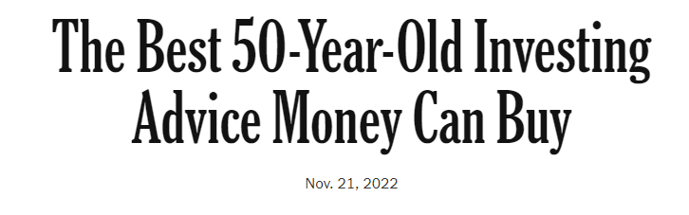
It is not often in life that the easy thing to do is the smart thing to do”
Burton Malkiel
Quote from Burton Malkiel interview by Peter Coy in NY Times
https://www.nytimes.com/2022/11/21/opinion/burton-malkiel-random-walk-down-wall-street.html

Slide 47
suggested rESOURCES
Books
The One Page Financial Plan (Carl Richards)
The Millionaire Next Door (Thomas Stanley)
“Guide to Investing” & “Guide to Retirement” (Bogleheads)
Rich AF (Vivan Tu – aka Your Rich BFF)
Columnists/Websites
401k.com
Ron Lieber/Tara Siegel Bernard/Carl Richards (NY Times)
CNN Money - Money 101
Bogleheads Forum
Blogs/ Podcasts
Big Law Investor; White Coat Investor
Her Money (Jean Chatzky)
"So Money with Farnoosh Torabi“
Brown Ambition (with Tiffany Aliche and Mandy Woodruff)
Jill on Money
Financial Advisors
XY Planning Network (Fee-Only, Fiduciary)
NAPFA (National Assn of Personal Financial Advisors (Fee-Only, Fiduciary)
Robo-Advisors (Betterment, Wealthfront, etc.)

Slide 48
Appendix

Slide 49
Trying to time the market. . . backfires
Annualized Performance
6%
2%
0%
Value of $10,000 Investment (2000 – 2019)
-2%
-4%
-5%
-7%
Fully Invested
Miss 10 Best Days
Miss 20 Best Days
Miss 30 Best Days
Miss 40 Best Days
Miss 50 Best Days
Miss 60 Best Days
Fully Invested
Miss 10 Best Days
Miss 20 Best Days
Miss 30 Best Days
Miss 40 Best Days
Miss 50 Best Days
Miss 60 Best Days

Slide 50

The data
15.2%
Gain during 1st month of a bull market (since 1928)
31.6%
Gain during first 3 months of a bull market (since 1928)
Stock surges have often begun when the outlook was bleak (i.e., they are hard to time)
Notes:
75 minutes is not enough time to turn you into Warren.
Also, many of you have significantly more institution investing experience than me working at banks, hedge funds, etc. You won’t here me talking about Sharpe ratios or derivatives.
This is more about giving you a framework and tools for how to think about personal investing.

Slide 51
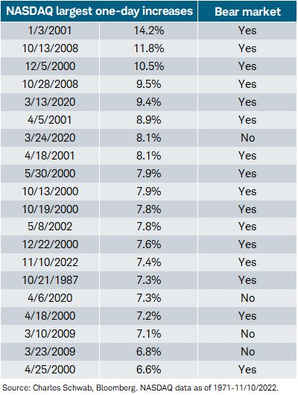
Real example from November 2022
Top 20 increases since 1971
16
of the top 20 single-day increases since 1971 came during a bear market
Notes:
75 minutes is not enough time to turn you into Warren.
Also, many of you have significantly more institution investing experience than me working at banks, hedge funds, etc. You won’t here me talking about Sharpe ratios or derivatives.
This is more about giving you a framework and tools for how to think about personal investing.

Slide 52
Disclaimer
This presentation is a general overview of principles you may want to consider. Only you can decide what is best for you. This presentation is educational in nature and is not intended to be, and should not be construed as tax, legal or investment advice. You should always consult a certified advisor for advice on your specific situation. The examples used in this presentation are for illustrative purposes only.
Notes:
Does this work for the below slide?

Slide 53
More Questions?

Slide 54
Wintersession 2024
Thank you!

Slide 55





Keep in
Touch
huecu@harvard.edu
huecu.org
@myHUECU
Find us on all social channels
104 Mount Auburn Street
Cambridge, MA 02138
Notes:
We have two more Wintersession workshops on Thursday: one on Investing 101, and an interactive Investing Q&A

